Slide 1


Slide 2
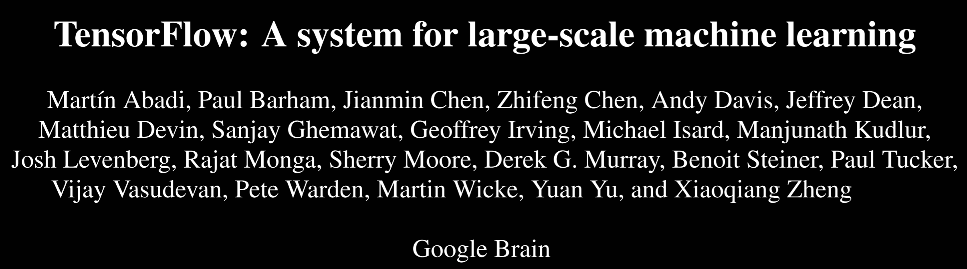

Slide 3
Context
Huge need for high-productivity tools for building solutions to machine-learning problems.
Current infrastructures force people to reinvent the wheel
Spark/RDD model illustrates power that better tools bring, but remains very low level: an RDD can deal with “anything” and is really just a small code applet.
TensorFlow builds off idea that ML applications are best understood by thinking about structured data: tensors

Slide 4
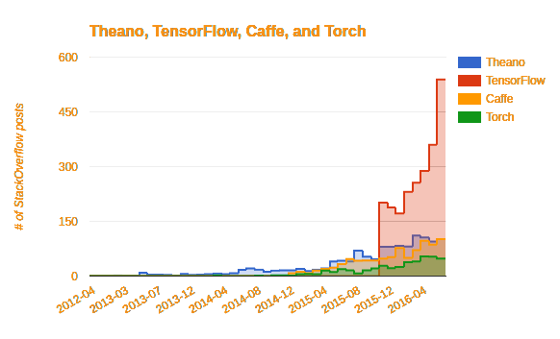
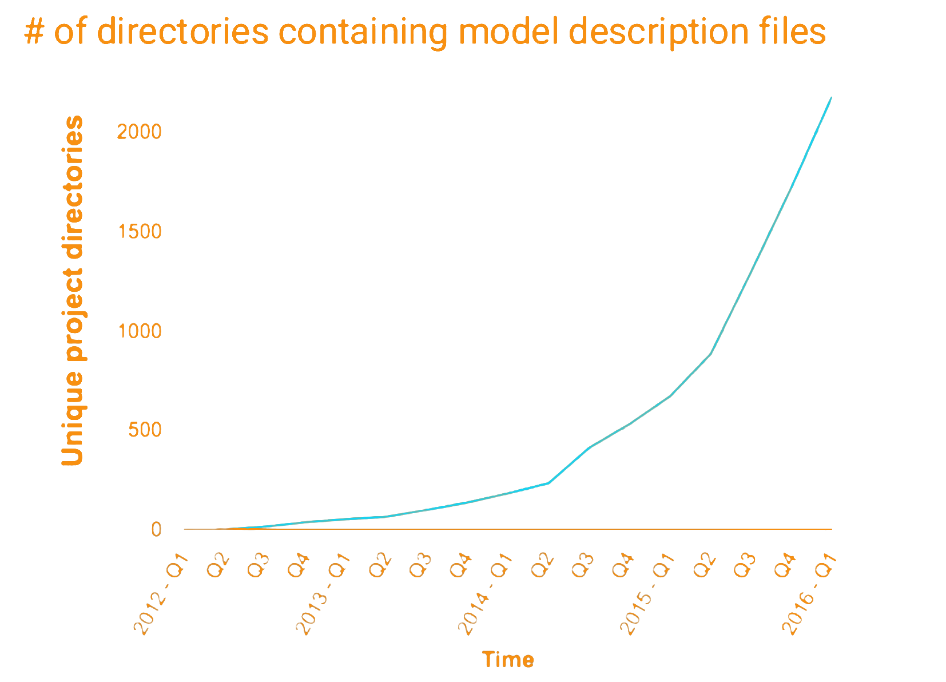
TensorFlow is Incredibly Popular

Slide 5
What’s the magic?

Slide 6


Python+Dataflow Programming

Slide 7
DataFlow Programming Example
Constant 3
Add
Constant 4

Slide 8
DataFlow Programming Example
node1 = tf.constant(3.0, dtype=tf.float32) node2 = tf.constant(4.0, dtype=tf.float32) node3 = tf.add(node1,node2)

Slide 9
What’s going on here?

Slide 10
Core TensorFlow constructs
Dataflow Graphs: entire computation
Data Nodes: individual data or operations
Edges: implicit dependencies between nodes
Operations: any computation
Constants: single values (tensors)

Slide 11
Core TensorFlow constructs
All nodes return tensors, or higher-dimensional matrices
How a node computes is indistinguishable to TensorFlow
You are metaprogramming. No computation occurs yet!

Slide 12
Running code
tf.Session().run(node3) #returns 7
Notes:
Previous slides built a graph, but did not run code

Slide 13
Placeholders (inputs) and how to use them
node1 = tf.placeholder(tf.float32) node2 = tf.placeholder(tf.float32) node3 = tf.add(node1,node2)
tf.Session().run(node3, {node1 : 3, node2 : 4})
Notes:
You need to specify all placeholders on which the *subgraph you are using for your computation* depends.

Slide 14
Variables (mutable state)
W = tf.Variable([.3], dtype=tf.float32) b = tf.Variable([-.3], dtype=tf.float32) x = tf.placeholder(tf.float32) linear_model = W * x + b #Operator Overloading! init = tf.global_variables_initializer() with tf.Session() as sess: sess.run(init)
sess.run(linear_model)
Notes:
Now, at this point we might be interested in invoking run() at different points in the graph. To facilitate this, we’re going to open a new scope for the tensorflow session (whereas before we were creating a one-shot session).

Slide 15
Where does code run?
Notes:
The whole point of having a dataflow representation is flexibility in choosing location. Tensorflow lets you do this

Slide 16

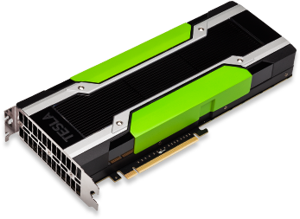
Specifying devices using with blocks
with tf.device("/cpu:0"): W = tf.Variable(...) V = tf.Variable(...) with tf.device("/gpu:0") output = tf.some_fancy_math(input, W) + b
CPU:0
GPU:0

Slide 17

Specifying devices using with blocks
with tf.device("/task:0/cpu:0"): W = tf.Variable(...) V = tf.Variable(...) with tf.device("/task:1/gpu:0") output = tf.some_fancy_math(input, W) + b
task:0/CPU:0
task:1/GPU:0
Notes:
Devices don’t have to live on the same Node!

Slide 18
Starting remote TensorFlow nodes
#all the machines mentioned in the dataflow graph cluster = tf.train.ClusterSpec([ip1:p1,ip2:p2,...]) #task_index is set to my "id" server = tf.train.Server(cluster,task_index=0) #begin listening server.join()

Slide 19
Server actions
Sessions run code on subgraphs; can parallelize by splitting input
with tf.device("/task:n"): half_input = tf.Variable(input[:len(input)/2]) work = tf.CoolFeature(half_input) cluster = tf.train.ClusterSpec(...) server = tf.train.Server(cluster, task_index=n) with tf.Session(server.target) as sess: sess.run(work)

Slide 20
Suggested System Design

Slide 21
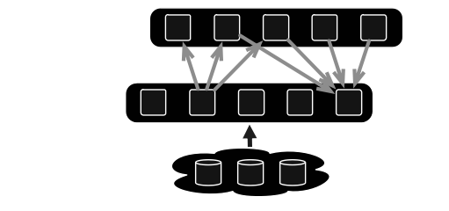
Suggested Design: parameter server
TensorFlow allows naming groups of nodes by their role: useful!

Slide 22
Parameter server focus :
Hold Mutable state
Apply updates
Maintain availability
Group Name: ps

Slide 23
Worker focus:
Perform “active” actions
Checkpoint state to FS
Mostly stateless; can be restarted
Group name: worker

Slide 24
Parameter server example
with tf.device("/jobs:ps/task:0/cpu:0"): W = tf.Variable(...) b = tf.Variable(...) inputs = tf.split(0,num_workers,input) outputs = [] for i in range (num_workers): with tf.device("/job:worker/task:%d/gpu:0" % i): outputs.append(tf.matmul(input[i],W) + b)

Slide 25
And that’s it!
For most TF applications, you don’t need to know more.
But this is because most TF runs are just a few steps, like a Spark job that performs a few actions on some RDDs
What about using TF for long-term jobs that continuously process input, like events from a smart highway?
The model still makes sense, but now fault-tolerance would be an issue
Control of concurrency / consistency could begin to matter, too.

Slide 26
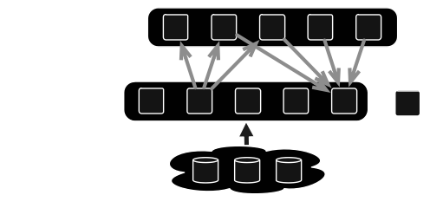
Adding Fault tolerance
Leader

Slide 27
Distinguished Leader
Hardcoded role. No worries about leader election, no consensus
saver = tf.train.Saver(sharded=True) with tf.Session(server.target) as sess: while True: ... #sleep a bit saver.save(sess, "gs://path/to/dump") if (bad_thing_happens): saver.load(sess,"gs://path/to/dump")

Slide 28

Adding Fault tolerance
Leader

Slide 29

Adding Fault tolerance
Leader

Slide 30
Adding Fault tolerance
Leader

Slide 31

Adding Fault tolerance
Leader
RESTART FROM CHECKPOINT!

Slide 32
Adding Fault tolerance
Leader

Slide 33

Adding Fault tolerance
Leader
CALL THE OPERATOR! MANUAL INTERVENTION!

Slide 34
You write most of this orchestration yourself.
There are libraries, but they are still a bit painful.
Remember to create frequent checkpoints Bottom line is that by default, TF is not consistent and is good at restarting from a checkpoint. Recent events not in a checkpoint can be forgotten.

Slide 35
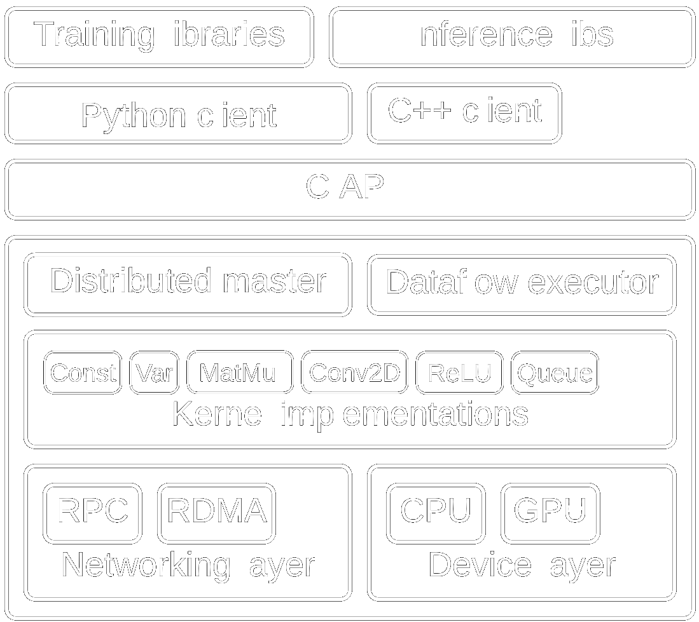
TensorFlow implementation
Semi-interpreted
Call to kernel per primitive operation
Can batch operations with custom C++
Basic type-safety within dataflow graph (error at graph construction time)
Global Names: overlapping TF instances share variables!
Notes:
Distributed Master: compiles the graph, including specialization. Think of it kind of like a query optimizer, but honestly it’s really an impoverished compiler
Dataflow executor: the scheduler and coordinator, responsible for invoking kernels on various devices.

Slide 36
Synchronous vs Asynchronous
Determined by node: Queue nodes used for barriers
Synchronous nearly as fast as asynchronous
Default model is asynchronous

Slide 37
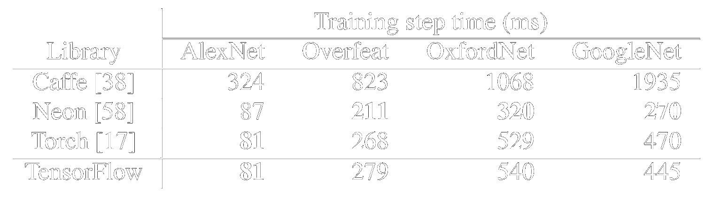
Performance: Single Node
Notes:
Remember, we’re really looking for the overhead caused by generality here. TF is pretty close to Torch, because it shares the same kernels. This shows us that TensorFlow does not suffer significant slowdown compared to a system whose core operations are the same but whose configuration is baked in.

Slide 38
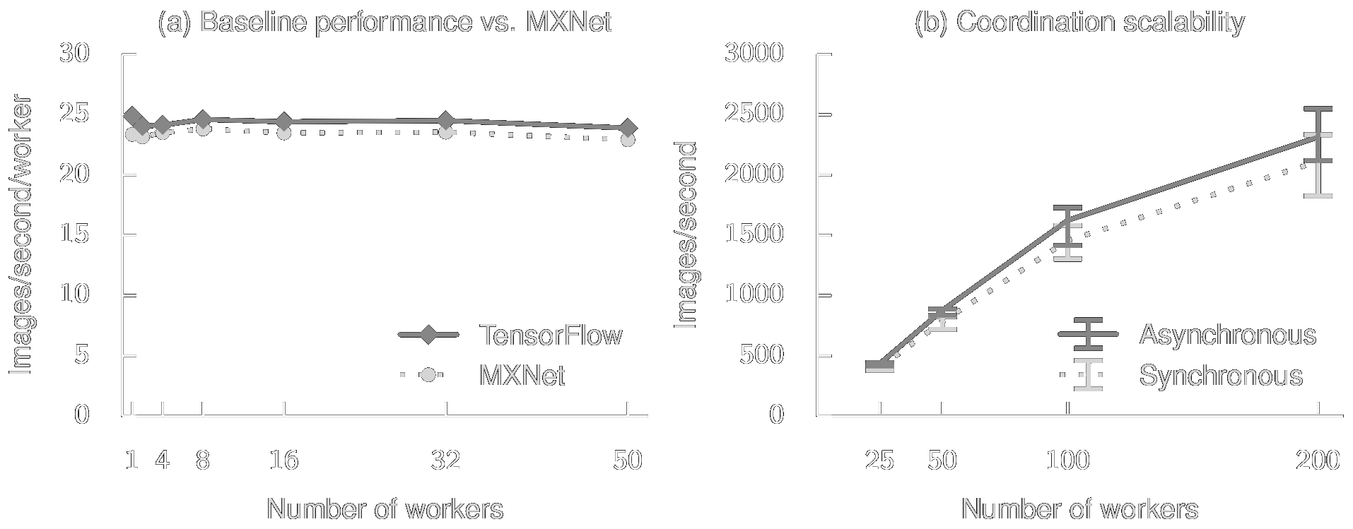
Performance: Distributed Throughput
Notes:
MXNet is a deep-learning specific distributed library. TensorFlow isn’t much faster, but it’s *much* more general, so we should be happy that it’s even a little faster.

Slide 39
Key Contributions
Programmability
Accessibility / ease of use
Richness of Libraries
Ready-made community

Slide 40
TensorFlow Example from warmspringwinds.github.io
Developer teaches courses and consults in BigData analysis
This is an open-source example he posted using TensorFlow to classify vehicles on a road, like a smart highway would do.
Core steps: Load image, segment it, tag the objects
A very simple case but it illustrates the ideas

Slide 41
Daniil’s example program, and output
Link to the GitHub Example

